Slide 1
Lecture 12-13
Probabilistic Information Retrieval

Slide 2
Why probabilities in IR?
User
Information Need
Query
Representation
Understanding
of user need is
uncertain
How to match?
Document
Representation
Uncertain guess of
whether document has relevant content
Documents
In vector space model (VSM), matching between each document and
query is attempted in a semantically imprecise space of index terms.
Probabilities provide a principled foundation for uncertain reasoning.
Can we use probabilities to quantify our uncertainties?

Slide 3
Probabilistic IR topics
Classical probabilistic retrieval model
Probability ranking principle, etc.
Binary independence model (≈ Naïve Bayes text cat)
(Okapi) BM25
Bayesian networks for text retrieval
Language model approach to IR
An important emphasis in recent work
Probabilistic methods are one of the oldest but also one of the currently hottest topics in IR.

Slide 4
The document ranking problem
We have a collection of documents
User issues a query
A list of documents needs to be returned
Ranking method is the core of an IR system:
In what order do we present documents to the user?
We want the “best” document to be first, second best second, etc….
Idea: Rank by probability of relevance of the document w.r.t. information need
P(R=1|document_{i}, query)

Slide 5
Recall a few probability basics
For events A and B:
Bayes’ Rule
Odds:
Prior
Posterior

Slide 6
Probability Ranking Principle
Let x represent a document in the collection.
Let R represent relevance of a document w.r.t. given (fixed)
query and let R=1 represent relevant and R=0 not relevant.
Need to find p(R=1|x) - probability that a document x is relevant.
p(R=1),p(R=0) - prior probability
of retrieving a relevant or non-relevant
document
p(x|R=1), p(x|R=0) - probability that if a relevant (not relevant) document is retrieved, it is x.

Slide 7
Probability Ranking Principle
How do we compute all those probabilities?
Do not know exact probabilities, have to use estimates
Binary Independence Model (BIM) – which we discuss next – is the simplest model
Questionable assumptions
“Relevance” of each document is independent of relevance of other documents.
Really, it’s bad to keep on returning duplicates
“term independence assumption”
terms’ contributions to relevance are treated as independent events.

Slide 8
Probabilistic Retrieval Strategy
Estimate how terms contribute to relevance
How do things like tf, df, and document length influence your judgments about document relevance?
A more nuanced answer is the Okapi formulae
Spärck Jones / Robertson
Combine to find document relevance probability
Order documents by decreasing probability
Notes:
In addition to the “document independence assumption” on previous slide, we have a “term independence assumption”: terms’ contributions to relevance are treated as independent events.
Okapi is one particular way of estimating probability given tf, df, and length.

Slide 9
Probabilistic Ranking
Basic concept:
“For a given query, if we know some documents that are relevant, terms that occur in those documents should be given greater weighting in searching for other relevant documents.
By making assumptions about the distribution of terms and applying Bayes Theorem, it is possible to derive weights theoretically.”
Van Rijsbergen

Slide 10
Binary Independence Model
Traditionally used in conjunction with PRP
“Binary” = Boolean: documents are represented as binary incidence vectors of terms (cf. IIR Chapter 1):
iff term i is present in document x.
“Independence”: terms occur in documents independently
Different documents can be modeled as the same vector

Slide 11
Binary Independence Model
Queries: binary term incidence vectors
Given query q,
for each document d need to compute p(R|q,d).
replace with computing p(R|q,x) where x is binary term incidence vector representing d.
Interested only in ranking
Will use odds and Bayes’ Rule:

Slide 12
Binary Independence Model
Constant for a given query
Needs estimation
Using Independence Assumption:

Slide 13
Binary Independence Model
Since x_{i} is either 0 or 1:
Let
Assume, for all terms not occurring in the query (q_{i}=0)

Slide 14
 | document | relevant (R=1) | not relevant (R=0)
term present | x_{i} = 1 | p_{i} | r_{i}
term absent | x_{i} = 0 | (1 – p_{i}) | (1 – r_{i})

Slide 15
Binary Independence Model
All matching terms
Non-matching query terms
All matching terms
All query terms
Notes:
Put all terms in query into right product and then divide through by them in left product.

Slide 16
Binary Independence Model
Constant for
each query
Only quantity to be estimated
for rankings
Retrieval Status Value:

Slide 17
Binary Independence Model
All boils down to computing RSV.
The c_{i} are log odds ratios
They function as the term weights in this model
So, how do we compute c_{i}’s from our data ?

Slide 18
Binary Independence Model
Estimating RSV coefficients in theory
For each term i look at this table of document counts:
Estimates:
For now,
assume no
zero terms.
See later
lecture.

Slide 19
Estimation – key challenge
If non-relevant documents are approximated by the whole collection, then r_{i} (prob. of occurrence in non-relevant documents for query) is n/N and

Slide 20
Estimation – key challenge
p_{i} (probability of occurrence in relevant documents) cannot be approximated as easily
p_{i} can be estimated in various ways:
from relevant documents if know some
Relevance weighting can be used in a feedback loop
constant (Croft and Harper combination match) – then just get idf weighting of terms (with p_{i}=0.5)
proportional to prob. of occurrence in collection
Greiff (SIGIR 1998) argues for 1/3 + 2/3 df_{i}/N

Slide 21
Probabilistic Relevance Feedback
Guess a preliminary probabilistic description of R=1 documents and use it to retrieve a first set of documents
Interact with the user to refine the description: learn some definite members with R=1 and R=0
Reestimate p_{i} and r_{i} on the basis of these
Or can combine new information with original guess (use Bayesian prior):
Repeat, thus generating a succession of approximations to relevant documents
κ is
prior
weight
Notes:
explicit Bayesian smoothing with a prior

Slide 22
Iteratively estimating p_{i} and r_{i} (= Pseudo-relevance feedback)
Assume that p_{i} is constant over all x_{i} in query and r_{i} as before
p_{i} = 0.5 (even odds) for any given doc
Determine guess of relevant document set:
V is fixed size set of highest ranked documents on this model
We need to improve our guesses for p_{i} and r_{i}, so
Use distribution of x_{i} in docs in V. Let V_{i} be set of documents containing x_{i}
p_{i} = |V_{i}| / |V|
Assume if not retrieved then not relevant
r_{i} = (n_{i} – |V_{i}|) / (N – |V|)
Go to 2. until converges then return ranking

Slide 23
Okapi BM25: A Non-binary Model
The BIM was originally designed for short catalog records of fairly consistent length, and it works reasonably in these contexts
For modern full-text search collections, a model should pay attention to term frequency and document length
BestMatch25 (a.k.a BM25 or Okapi) is sensitive to these quantities
From 1994 until today, BM25 is one of the most widely used and robust retrieval models

Slide 24


Okapi BM25: A Nonbinary Model
The simplest score for document d is just idf weighting of the query terms present in the document:
Improve this formula by factoring in the term frequency and document length:
tf _{td} : term frequency in document d
L_{d} (Lave): length of document d (average document length in the whole collection)
k₁: tuning parameter controlling the document term frequency scaling
b: tuning parameter controlling the scaling by document length

Slide 25
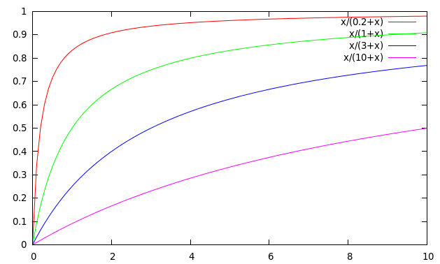
Saturation function
For high values of k₁, increments in tf_{i} continue to contribute significantly to the score
Contributions tail off quickly for low values of k₁

Slide 26
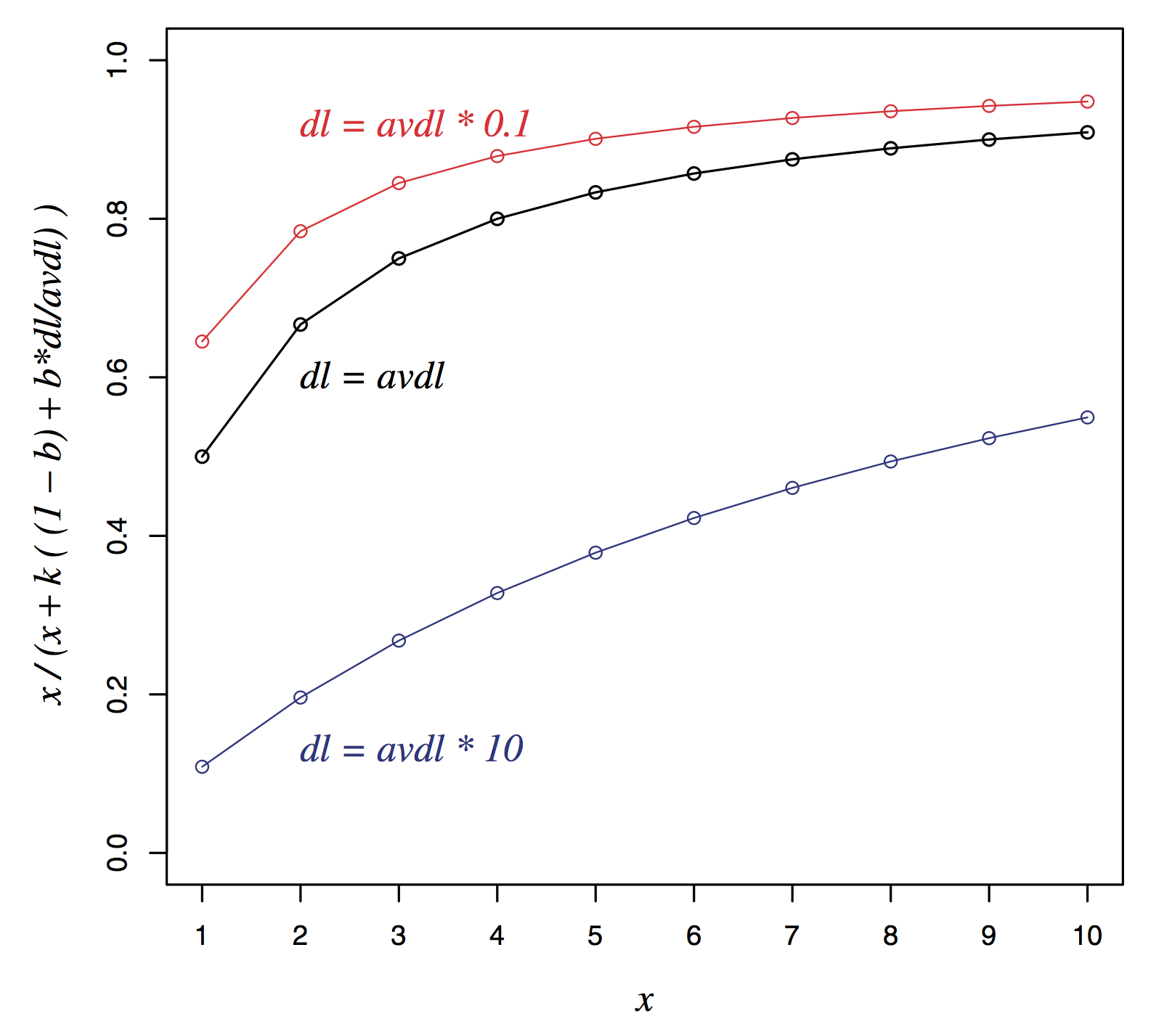
Document length normalization

Slide 27

Okapi BM25: A Nonbinary Model
If the query is long, we might also use similar weighting for query terms
tf _{tq}: term frequency in the query q
k₃: tuning parameter controlling term frequency scaling of the query
No length normalisation of queries (because retrieval is being done with respect to a single fixed query)
The above tuning parameters should ideally be set to optimize performance on a development test collection. In the absence of such optimisation, experiments have shown reasonable values are to set k₁ and k₃ to a value between 1.2 and 2 and b = 0.75

